Slide 1

The principles seem obvious but applying them in practice is not easy:
Health promotion quality evaluation in Indigenous Primary Health Care
Nikki Clelland¹, Lynette O’Donoghue¹,
Prof Vivian Lin^{2,} Prof Ross Bailie¹
Australasian Evaluation Society International Conference
31 Aug – 2 Sept 2011, Sydney, Australia
¹ Menzies School of Health Research, Charles Darwin University, Darwin
² LaTrobe University, Melbourne
Notes:
Hello, and thankyou for taking the time to hear my presentation today. I would like to take this opportunity to acknowledge the Traditional Owners of the land on which we meet and to pay my respects to Aboriginal Elders both past and present.
I would like to recognise the valuable input and guidance of my co-authors, Lynette O’Donoghue, Ross Bailie and Vivian Lin who cannot be here with us today
As xxxx, mentioned, I’m a researcher at Menzies School of Health Research and I’m based in Brisbane. I wouldn’t say that I am an ‘evaluator’ but I have some skills that I believe are synonymous with aspects of evaluation practice. My talk today is based on much of the work I have done during my PhD candidature. My thesis is something I’ve yet to finalise…..but that’s another story.

Slide 2
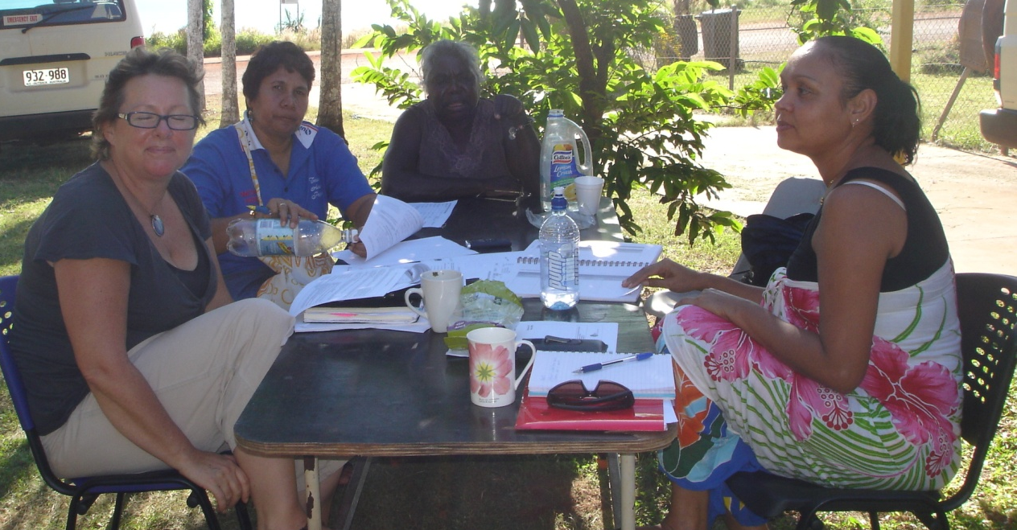
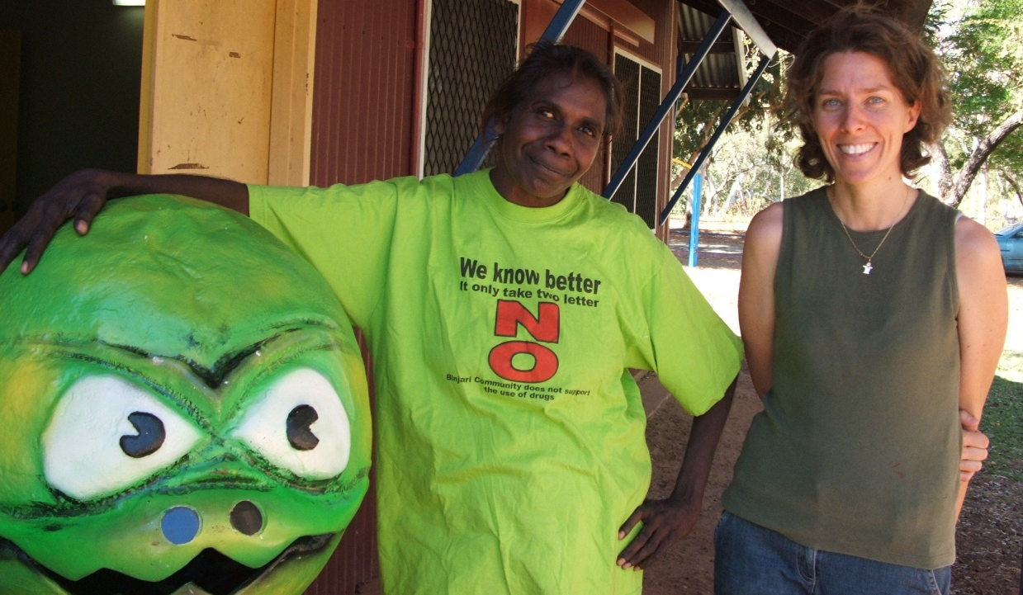
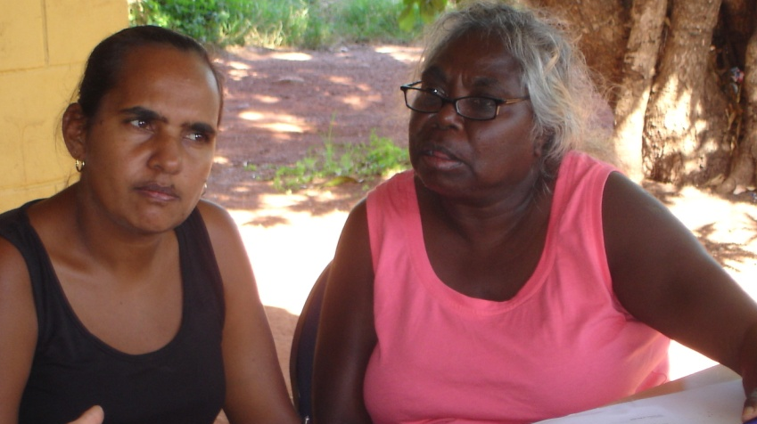
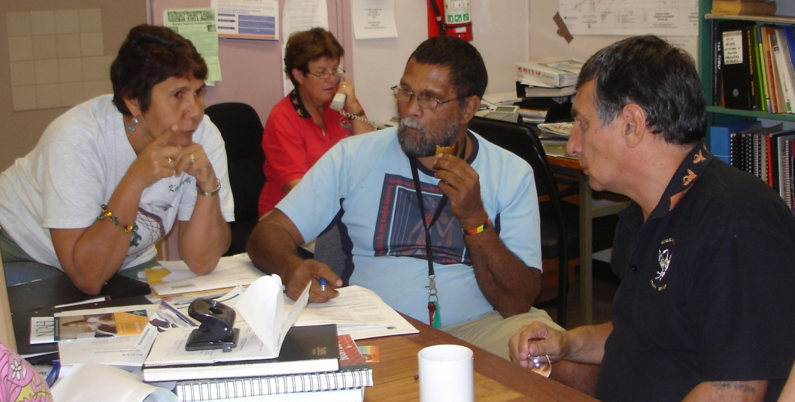
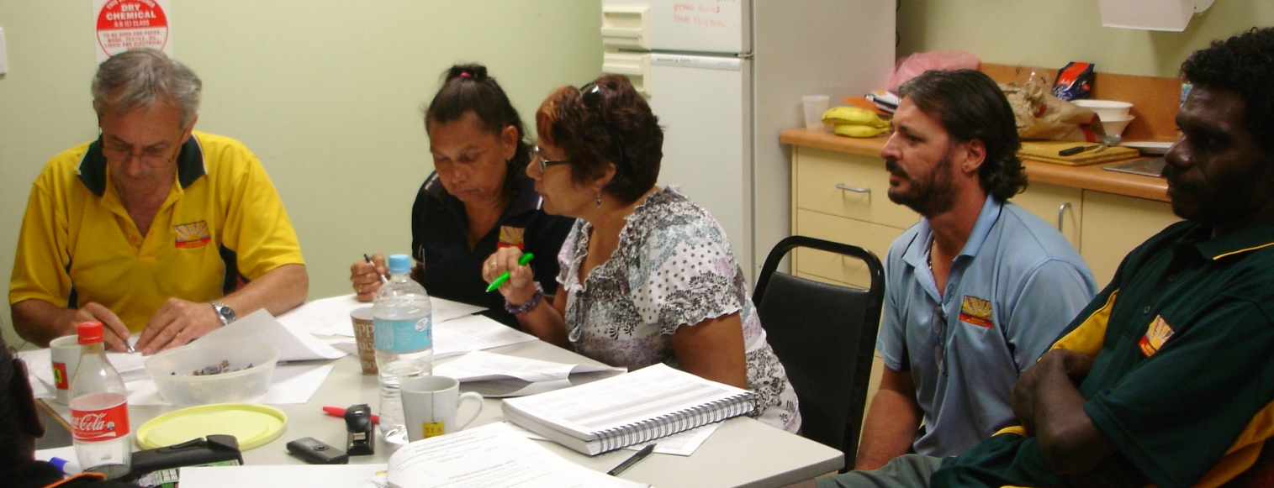
Support & Funding
CRC for Aboriginal Health
NHMRC
Notes:
This presentation would not have been possible without many people who have invested their time, thoughts and energy into this research.
I would like to acknowledge and thank them for their ongoing commitment to improving Aboriginal and Torres Strait Islander health.
And to acknowledge our funding sources – the Cooperative Research Centre for Aboriginal Health and the National Health and Medical Research Council.

Slide 3
Our journey began…..
‘a lack of clear policy direction and of reasonable performance indicators that capture the provision of public health and in particular, health promotion services’
The stars aligned:
  Policy agenda (evidence based, measurable)
  Potential solution (improving health systems and quality of health care)
  Stakeholder engagement
  Optimistic (but cautious) researcher

Slide 4
What is Continuous Quality Improvement?
Method for organising health systems
  ‘a structured organisational process for involving personnel in planning and executing a continuous stream of improvements in systems in order to provide quality health care that meets or exceeds customer expectations.’ McLaughlin CP and Kaluzny AD (1994)
Modern quality improvement principles
  Best evidence
  Engagement of managers and practitioners
  Good quality data on systems, processes and outcomes
  Raising general standard of care (not pockets of poor practice)
  No blame
Notes:
Continuous quality improvement or CQI, is based on the theory that most problems in the quality of health care stem from poorly organised and fragmented health systems. CQI interventions therefore have an emphasis on improving the way systems function.
CQI principles:
Quality is assessed based on the best available evidence. Often we are busy but are we busy doing the right thing
Participation and engagement of those in the system are paramount to the improvement process
Decisions need to be made on good quality data
Focus is on raising general standards of care not pockets of poor practice
No blame culture

Slide 5
ABCD approach to CQI
Core features of ABCD/CQI:
  Emphasis on systems
  Structured approach
  Participatory action learning
ABCD = improved systems, processes & outcomes in health care (Bailie et al (2007) MJA; Si et al (2008) BMC Health Services Research; Si et al (2007) MJA)
Plan-Do-Study-Act Cycles
Bailie et al MJA (2007)
Notes:
In the Australian Indigenous primary health care context, the Audit and Best Practice for Chronic Disease or ABCD continuous quality improvement intervention, has shown evidence of improvements in health centre systems, processes and outcomes of health care.
This quality improvement program uses a planned, step by step approach based on annual plan-do-study-act cycles – illustrated by this circle.
The cycle begins with the negotiation and signing of a participation agreement and local orientation and training for health centre staff.
Then, audit tools are used to collect information on the quality of practice and on how well health centre systems are functioning in order to support practice.
These data are analysed and interpreted to suit the local health centre context and a report is prepared for each health service.
Feedback workshops are organised where key messages are presented and discussed in order for health teams to develop goals and local action plans. The success of these goals can then be monitored at the start of the next cycle, and so on and so on.
ABCD emphasises the participation of people involved in service delivery. It is their intimate knowledge and understanding about their work and the systems that support them to carry out this work that are essential to facilitating improvement.
It was on the back of the ABCD success, that we initiated a 3 year investigation into the feasibility of this or a similar model in health promotion.

Slide 6


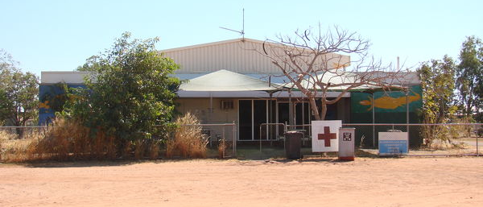
Study Aim & Objectives
Develop and trial ABCD (CQI) model in HP
  Develop CQI tools
  Implement over 2 cycles
  Describe HP & Systems
  Describe changes over time
  Feasibility of CQI in HP
Notes:
The objectives of this research were to develop and introduce quality improvement tools and processes in health promotion in 4 Australian Indigenous primary health care centres,
to describe changes over the course of two annual cycles and on this basis,
discuss the extent to which the approach is feasible in health promotion.

Slide 7
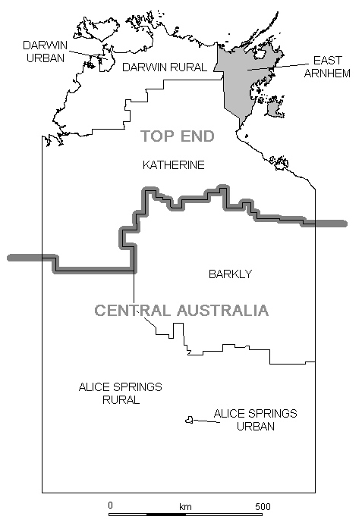
Study Context
Forefront of PHC
High burden of disease
  Acute care / clinical focus
  Multidisciplinary teams (5 to >50 staff) nurses, allied health, doctors and Aboriginal health workers
Restricted/seasonal access
  20km to 600km to nearest centre
Notes:
Prepared by Nikki Clelland
It is worth mentioning just briefly the settings for this research.
About 90% of Indigenous people in the Northern Territory live in discrete Indigenous communities. The majority of these people access primary health care through community health centres rather than through private doctors or general practice as do the majority of Australians.
So importantly, the health services participating in our study are at the forefront of health care for many Indigenous people.
The burden of ill health in Indigenous communities also means that acute care and clinical services dominate with much less emphasis on health promotion and prevention aspects of primary health care.
This focus on clinical health care has also contributed to the composition and skills of the workforce. These health centres employ multidisciplinary teams of 5 to more than 50 staff including nurses, allied health, doctors and Aboriginal Health Workers.
Access to these communities can also be difficult – some can only be reached by air or sea and driving is restricted during the rainy season. Distance to the nearest urban centre maybe less than 20km or up to 600kms by road.
I will now describe the quality improvement tools and discuss the challenges we’ve experienced from their application in this context of Indigenous primary health care.

Slide 8
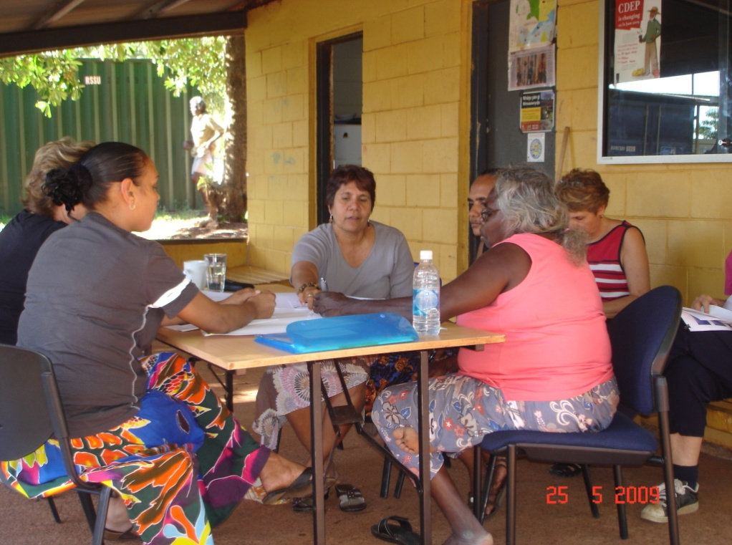
The Quality Improvement Tools
What supports our team to plan & do health promotion?
Are we doing the right things the right way?
Health Promotion Audit Tool
  Alignment with best practice
  Review of health centre records
Health Promotion Systems Assessment Tool (SAT)
  Strengths and weaknesses of systems for health promotion
  Facilitated group discussion
  Consensus score + justification
Notes:
A core component and an objective of this research has been the development of two quality improvement tools in health promotion.
The first is a health promotion audit tool. The purpose of this tool is to collect information that allows us to compare what is being done, and how well this aligns with the evidence base. Information is collected through a review of health centre records such as project plans and reports. Answering the audit tool questions gives us some insight into the quality of practice.
The second instrument is a systems assessment tool, or SAT. This tool is used to gather health centre teams perceptions on how well health centre systems are functioning to support their health promotion practice. Information is gathered through a facilitated group discussion. Teams discuss and arrive at a score between 0-11 which reflects the state of system development. Notes about how they arrived at this score are also recorded.
Both tools provide a structure and process for collecting data that are brought together and fed back to the health centre teams.
Prepared by Nikki Clelland
8

Slide 9

Challenges – Intervention & Context
Capacity in Indigenous primary health care
  Varied understanding of health promotion (workforce)
  Limited ‘records’ of practice (systems)
Notes:
Following the introduction of the tools in the quality improvement cycle, we discovered significant variation in individual staff involvement and understanding of health promotion . Many health centre staff understood health education to be the full extent of what health promotion entailed.
The ability of staff to do health promotion well, was further inhibited by the rudimentary or poorly organised health centre systems for supporting practice.
Just one example was the lack of documentary evidence like project plans or evaluation reports of health promotion.

Slide 10
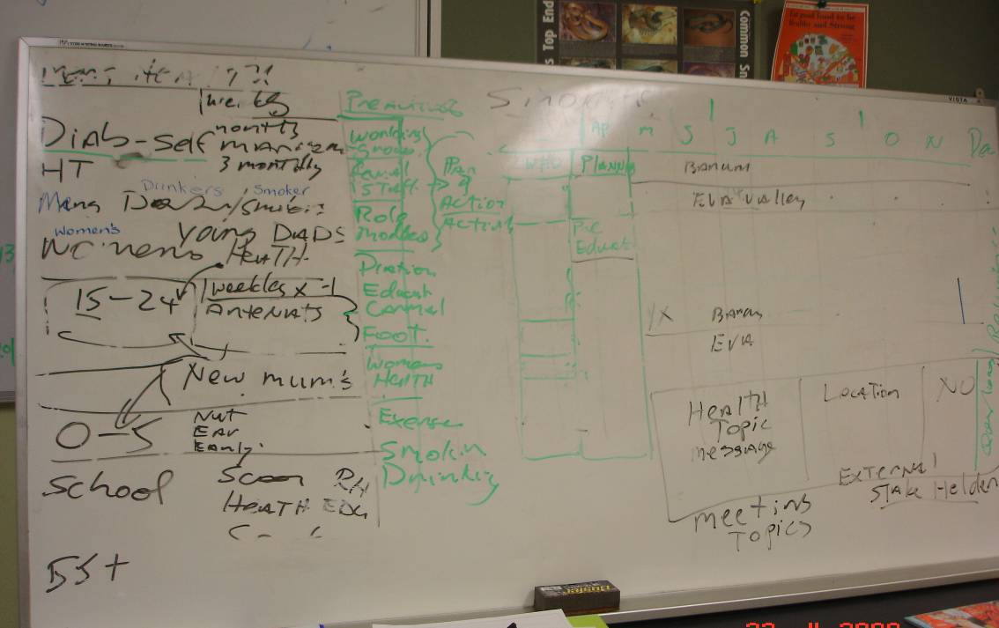
Documentation of Health Promotion
“In our men’s health program…we’ve been doing lots of small group education about lifestyle changes and that. Two of our men have been taken off the hypertensive list, no longer on medication. They’ve been there long time. But we couldn’t record what we did on the system.”
Aboriginal Health Worker

Slide 11
Challenges – Intervention & Context
Emphasis on quantifiable and measurable indicators
  Small numbers of ‘activities’, simple frequency analysis
  ‘like splitting hairs’ and ‘this is subjective, no objective end points identified’
If it gets measured, it gets noticed.
If it gets noticed, it gets done.
Centre for Strategy and Performance, University of Cambridge, http://www.ifm.eng.cam.ac.uk/csp/news/05april/5.html accessed 31 August 2011,
Notes:
But this emphasis on quantifiable measures and indicators has raised a number of challenges for health promotion.
Presentation of quantitative data is a popular feedback mechanism for health centre staff to demonstrate change in quality over time. For example, results of audits in clinical practice can be presented as the proportion of adults with a chronic disease who have a had
For health promotion, this required counting the occurrence of some aspects of practice like community participation – and has led some staff feeling like a yes/no answer was like ‘splitting hairs’. Yes, we had a health committee made up of community members who identified ‘smoking’ as an issue, but they had little to no involvement in designing the program.
We also heard comments that the nature of auditing health promotion practice was very subjective. Elements of health promotion practice, such as community participation and planning, were difficult to describe in a way that would facilitate the collection of standardised and comparable data across services over time.
This is a real challenge for health promotion in primary health care, given that most staff are trained in biomedical models of health care, and are more familiar with quantifiable indicators of performance. This is further enforced in an environment where the perception that more ‘numbers of activities’ equates to better outcomes.

Slide 12
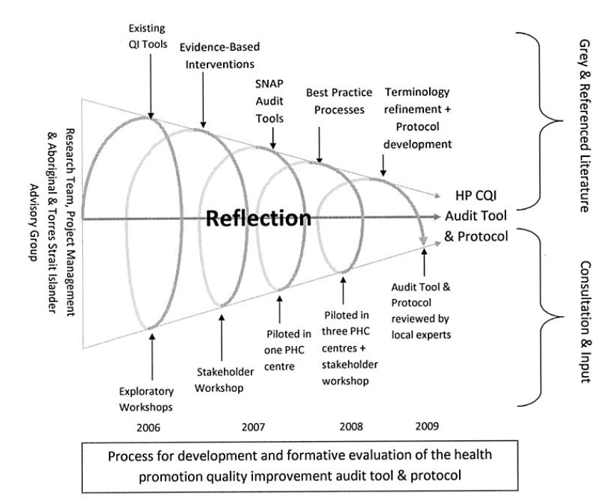
Evolution of the quality improvement tools
Notes:
This diagram illustrates the iterative process and the time taken to develop the health promotion quality improvements.
What I wld like to highlight here, is
the intertwining of literature and empirical evidence with consultation processes involving stakeholders and health centre staff (those who are affected by and should benefit from the quality improvement process).
We are in a situation where the evidence base for health promotion is both limited and generally, not applicable in the Indigenous PHC context. This was an important process in translating the ‘theory’ or ‘evidence’ of health promotion into ‘practice based’ reality.
The second aspect I would like to highlight is the time – We had not envisaged this amount of emergent practice! Ian Anderson highlighted the importance of engagement and developing relationships and this takes time. By taking this time, we have got to understand more about the daily business of health services, giving us insight into the state of play with respect to health promotion. This enabled us to change the focus of the tools in order to meet the needs and stage of system development in these services.
thirdly, I’d like to comment on the commitment and continuity of the research team throughout this process. I personally have found this important for maintaining relationships with people but also continuity in our research journey.
The result are tools that are not only based on empirical evidence but are relevant and practical to use.

Slide 13
Improved Understanding
‘I now see the importance of this recording to try see results from my work’ Aboriginal Health Worker
‘This teaches people about what health promotion actually is. It’s the first time I’ve seen it [HP] set out in a structured way’ Registered Nurse
When you mob came here last time, we all walked out thinking ‘what have we got ourselves in to! But now we can see what this is all about’ Aboriginal Health Worker
‘I’ve used the audit tool as a check list for planning my health promotion activities’ Health Promotion Coordinator
Notes:
Prepared by Nikki Clelland
But we have overcome some of these challenges through our approach to CQI and have witnessed some progress in improving health centre systems and health promotion practice.
These improvements in understanding may relate, at least in part, to our approach to facilitation of the quality improvement tools. We have developed a common language grounded in a two-way sharing of experiences and knowledge. Involvement in data collection, interpretation and feedback gives staff and our team, new understanding of what is going on and helps to make sense of what it means.
These are just some of the comments from staff of participating services about the educative and practical nature of the quality improvement approach.

Slide 14

Reflections

Slide 15
Lessons about context in quality evaluation
Impacts on evaluation methods (CQI Intervention)
  Auditing against evidence of effective interventions was unworkable in this context
  all or nothing (yes/no) does not allow or recognize interim progress in health promotion quality improvement
  Presenting (quantifiable) improvements in quality over time is difficult
Influences the availability and quality of information
  Signs of quality not quality of signs
  Systems for recording and monitoring practice
Notes:
Prepared by Nikki Clelland
Context impacts on the way evaluation methods are developed and applied:
Developing an audit tool based on evidence of effective interventions was unworkable in this context. The underdeveloped systems and capacity constraints significantly undermined the ability of staff to implement these interventions that were known to be effective in other contexts. An expectation to develop and implement these interventions also placed significant burden on primary health care staff who had already expressed concern about their capacity to do health promotion.
Secondly, the closed-ended nature of the audit items (yes/no and categorical responses) popular in clinical health care, was like ‘splitting hairs’ (ie. all or nothing – where all was best level) and did not allow/recognize progress towards achieving best practice. A scaled approach maybe more appropriate in this context.
The health promotion audit tool was useful for describing the scope and quality of health promotion at one point in time but we found it difficult to report on improvements in quality over time. This stems back to the challenge of developing meaningful indicators or criteria of health promotion quality that can be measured or captured.
Context also influences the availability and quality of information available
Through the audit process we gained insights into some ‘signs’ of good health promotion practice, for example whether community or external organizations were involved in health promotion, but we did not make an assessment of the quality of these processes, how meaningful was community engagement, that we know are important in developing and implementing effective health promotion interventions.

Slide 16
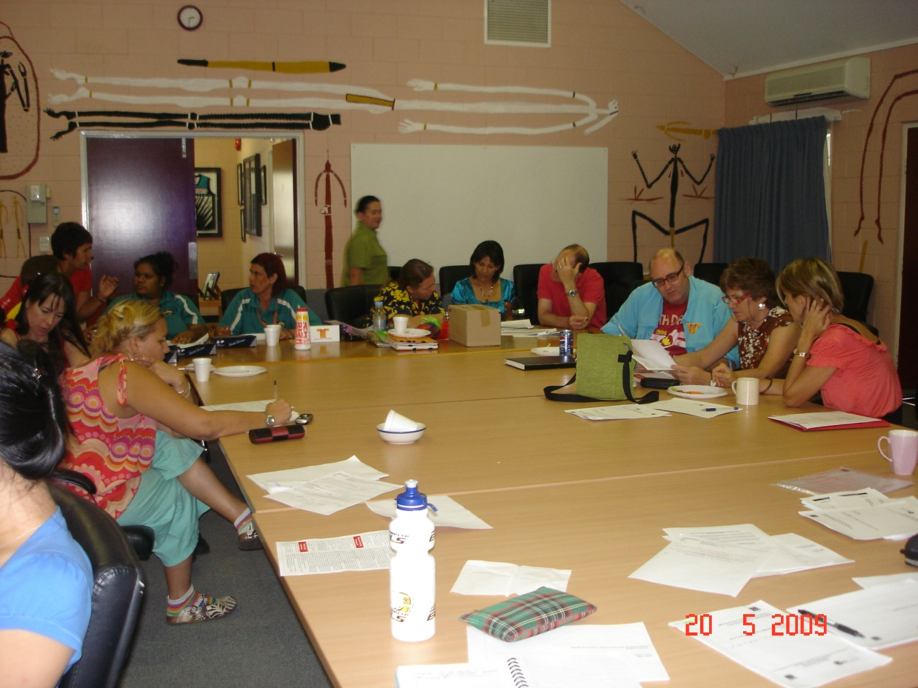
Lessons about context in quality evaluation
Critical in making evaluation findings actionable
  Participation and collaboration
  ‘can opener approach’ (Bate, 2002)
Notes:
Prepared by Nikki Clelland
Context is critical in making evaluation findings actionable.
Participation and collaboration is paramount in ensuring information is relevant and practical. We used the audit tools to elicit questions, rather than answers and thereby create a health promotion quality improvement dialogue.
{Bate, 2002 #4948} describes this as the ‘can opener approach’ where the process doesn’t necessarily give definitive answers but prompts interrogation and inquiry . This can opener approach has helped teams to engage and reflect on their data about what and how health promotion is done.

Slide 17

Can CQI be applied to health promotion?
Developed framework for health promotion quality
Emerging evidence improved practice and systems
Participatory approach is key
Potential for wider application and learning
Notes:
So, can CQI be applied to health promotion?
Through this research we have developed tools for describing the scope and quality of health promotion and the systems that support effective practice. Their use in a structured quality improvement framework has enabled health centre staff to develop a better understanding of health promotion.
It appears that these improvements may relate, in part, to our approach to development and facilitation of the quality improvement tools. The dialogue between the external facilitators and local health centre staff helps to build a shared understanding of how health promotion can be strengthened and integrated into health centre systems.
There is some evidence that the application of quality improvement tools and processes has supported a systematic assessment of the quality of practice and the state of system development in the Australian Indigenous primary health care context, which we believe has the potential for wider application and learning.

Slide 18
nikki.clelland@menzies.edu.au lynette.o’donoghue@menzies.edu.au ross.bailie@menzies.edu.au
Menzies School of Health Research www.menzies.edu.au
For more information:

Slide 19
Health Promotion Audit Tool
Are we doing the right things the right way?
key factors
  Comprehensive planning
  Systematic targeting
  Community participation
  Skilled delivery
  Partnerships
  Coverage & Reach
Yes/No + categorical questions
review of health centre records
Notes:
The first is the health promotion audit tool. The purpose of this tool is to assess the extent to which health promotion practice aligns with principles of best practice. It was through our development process that we identified 6 key factors as being for good practice. The audit tool includes questions related to each of these areas – comprehensive planning, systematic targeting, community participation, skilled delivery, partnerships and coverage and reach.
Health centre teams review their records or documents such as health promotion project plans and evaluation reports. Answering the yes/no and categorical questions gives us some insight into the quality of health promotion practice.

Slide 20
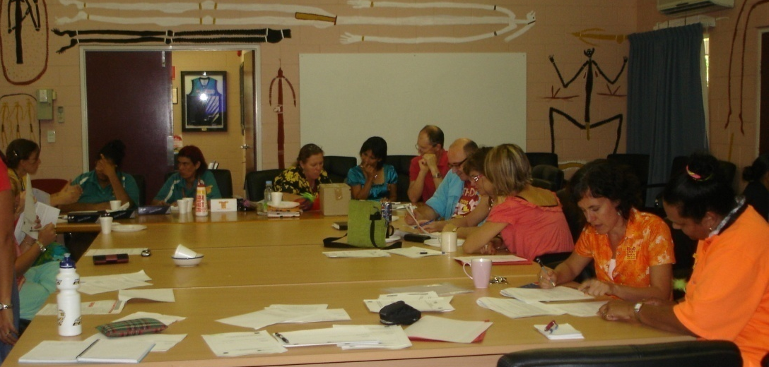
Health Promotion Systems Assessment
4 Components:
  Delivery system design
  Information systems & decision support
  Organisational environment
  Adaptability & Integration of systems
Facilitated group discussion
Consensus score [0-11] + score justification
No ‘right’ or ‘wrong’ answers
What supports our team to plan & do health promotion?
Notes:
The second quality improvement instrument is a systems assessment tool, or SAT, and this is used to gather data on how well health centre organisational systems are functioning to support best practice health promotion.
We modified the tool used in the ABCD quality improvement program, to include key aspects of health promotion systems such as standardised planning and evaluation processes, provision of staff professional development and training, identification of team roles and responsibilities, mechanisms for engaging community and arrangements for working with other organisations and agencies.
Information on the strengths and weaknesses of health centre systems are gathered through a facilitated group discussion. Health centre teams rate the state of development across a range of systems, using a scoring range from 0-11. Notes about how teams arrived at this score are also recorded.
Both the health promotion audit tool and systems assessment tools provide a structure and process for collecting data that are brought together and fed back to the health centre team for interpretation and review.
I will now present some of the findings following their introduction and use in the quality cycle.

Slide 21
Scope of Health Promotion (DHS, 2003)
Medical Approach Behavioural Approach Socio-environmental Approach
Healthy Individuals Healthy Communities, Settings & Environments
Screening, Individual Risk Assessment and Immunisation | Health Education and Skill Development | Health Information and Social Marketing | Community Action | Settings and Supportive Environments
SNAP BI Pap Smear Screening Well Adult Checks Child Health Checks | QUIT AFL NT School Holiday Program | Australia’s Healthy Weight Week Youth Week World Aids Day Drug Action Week | Diabetes Day Program Woman’s Camp Health Advisory Committee | Workplace Food & Nutrition Policy
Notes:
For this research, a crucial first step has been defining and identifying the scope of practice or what types of health promotion interventions are being delivered.
This intervention spectrum from the Victorian Department of Human Services (2003) to be particularly helpful for both communicating and describing the types of health promotion activities.
From the audits, we have found that most health promotion tends to be directed at the individual or lifestyle types of activities with less emphasis on collaborating with community or working towards policy, legislation or settings and supportive environments.
Much of the health promotion work is simply responding to event driven marketing initiatives such as national health week campaigns or awareness days that are mailed out and disseminated to health centres. Here are just a few examples, SNAP or smoking nutrition alcohol and physical activity brief interventions, QUIT smoking courses, Diabetes Day program, Drug Action Week events.
While we haven’t seen much movement towards the more ‘upstream’ interventions over the course of the research, the quality of practice certainly has improved.

Slide 22
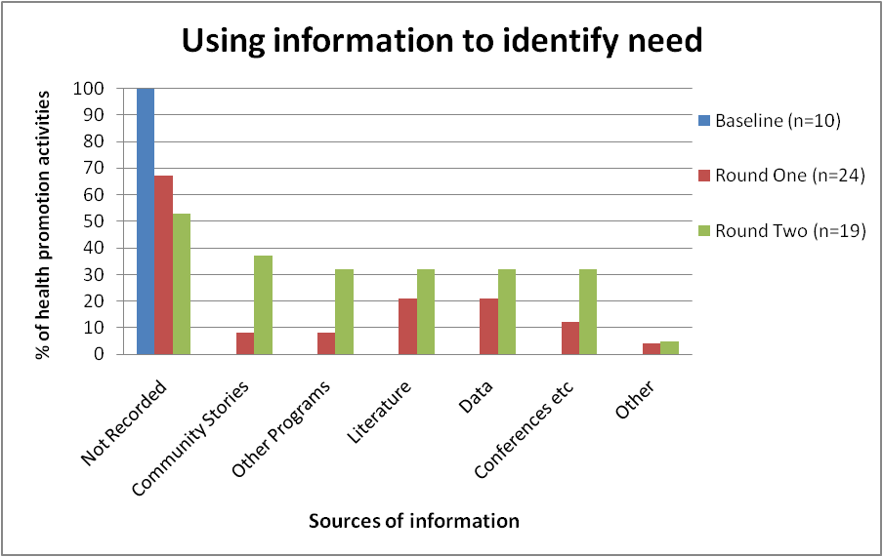
Practice Change & System Development
Notes:
This graph illustrates just some of the practice changes that have taken place over the course of the research. These data are taken from a review of health centre records where we searched for the processes health centres used for identifying and determining community health issues or needs.
As you can see, at baseline there was no evidence of any needs assessments which is clearly evident by the blue bar.
Over the course of two annual cycles, we can see documentation has improved – by round two, shown by the green bar, about half of health promotion activities included evidence of a needs assessment process.
This graph also gives us more information on the range of needs assessment processes that have been used for identifying community health priorities – for example, felt needs gathered from community stories, comparative needs on what is available from other programs or services, expressed needs which are drawn from local population health data or community profile data and normative needs based on the opinions of experts at conferences, local health centre staff or according to current research evidence or literature.
This information is important because each needs assessment process requires different systems to support their effective implementation. For example, the process for gathering community stories is quite different from collecting statistics on burden of disease.
These improvements in practice appear to be related to firstly, health centre teams having a better understanding of health centre systems and secondly the development or improvements in existing systems that support planning and recording of health promotion.

Slide 23

Findings: Systems Changes
System Reorientation:
roles and responsibilities
time and space
Improved system functioning
existing community governance structures and working groups
Development of new systems
electronic & paper based planning templates
What supports our team to plan & do health promotion?
Notes:
Prepared by Nikki Clelland
With this improved understanding, health centre teams are better able to identify the strengths and weaknesses in their health centre systems and develop strategies for improvement.
By discussing the roles and responsibilities for health promotion with staff, the process has helped teams to match knowledge, skills and interest with the different aspects of practice. This has been particularly important given limitations in workforce expertise and time for health promotion.
In addition, participating in CQI has given teams the much needed time and space to talk and reflect on health promotion in their service.
With such an emphasis on clinical and curative care, these are early indications of the commitment to reorienting resources towards health promotion.
Secondly, there have been improvements in existing systems. There has been increased attention to engaging community and external partners by making better use of systems in place such as health boards and committees and cross-agency working groups. By encouraging health centre teams to reflect on their knowledge of systems that support clinical services, they have been able to better utilise them for the purpose of health promotion.
And finally, the development of new systems. The structure and content quality of health promotion documentation has improved significantly over the course of the research. This has stemmed from the introduction and creation of both electronic and paper based planning templates for recording and documenting practice.

